Slide 1
Deutero-Isaiah and Latent Semantic Analysis
Does God Speak in Threes?
Caleb Marshall & Dr. Erin Buchanan
Missouri State University
Department of Psychology

Slide 2
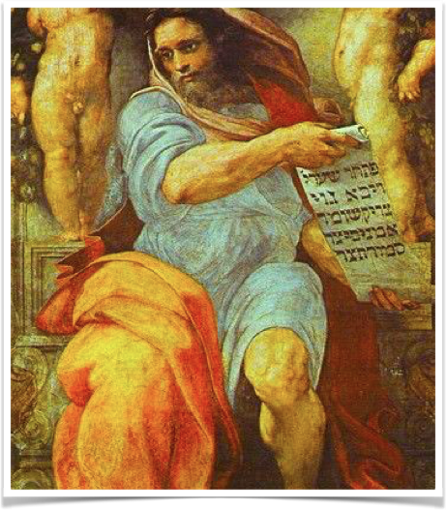
Isaiah
8th Century Jewish Prophet
Supposed Author of Latter Prophetic Writing
Recognized prophet in Judaism, Christianity and Islam.

Slide 3
Deutero-Isaiah Hypothesis
Strong possibility of multiple Isaiah authors
Variations in language and subject
Strong scholarly support (Brettler 2005)
Contradicts some religious traditions

Slide 4
Textual Analysis
Term-by-Term Analysis
Statistical Analysis
Frequentist

Slide 5
So what now?

Slide 6




Slide 7
Context and Latent Semantic Analysis
Instead of counting word frequency, what if we counted word relationship?
Contextual Semantics
Latent Semantic Analysis (Landauer & Dumais 1998; Jones 2010)

Slide 8
LSA and Isaiah
Comparing the Contextual Semantics of Proto-Isaiah (Chs. 1-39) to Deutero (40-55) and Trito (56-66) Isaiah.
Measuring term differences in Latent Semantic Space.
Used a standardized correlation measure.
Large correlation = More highly related
Small correlation = Less highly related

Slide 9
Method
Created a Latent Semantic Space for each chapter of Isaiah
Calculated the total cosine correlations for each chapter.
Compared cosine correlation for chapter pairs.
Also examined correlations for entirety of Isaiah.

Slide 10
Results
Cosine change from chapter-to-chapter was significant.
(r = -0.22, p < 0.0001)
Section correlations were significant.
No correlation from first Isaiah to Deutero/Trito Isaiah
r = -0.01, r = 0.02
Significant correlation between Deutero and Trito Isaiah
r = -0.25

Slide 11
What does this mean?

Slide 12
Possible Future Written Corpora
Genesis
Exodus
Joshua
Judges
Psalms
Gospels
Revelation
Virgil
Aeneid
Odyssey
Beowulf
Key of Solomon
1001 Nights
Shakespearean Plays

Slide 13
References
Harris, Z. S. (1954). Distributional Structure. Word Structure, 10(2–3), 146–162. https://doi.org/10.1007/978-94-009-8467-7_1
Jones, M. N., Willits, J., & Dennis, S. (2015). Models of Semantic Memory. Oxford Handbook of Mathematical and Computational Psychology, 232–254. Retrieved from http://psycnet.apa.org/psycinfo/2004-17297-001
Landauer, T. K., Folt, P. W., & Laham, D. (1998). An introduction to latent semantic analysis. Discourse Processes, 25(2), 259–284. https://doi.org/10.1080/01638539809545028
Pace, F. G. (1998). Textual Statistics . An Exploratory Tool for the Social Sciences Author ( s ): France Guerin-Pace Source : Population : An English Selection , Vol . 10 , No . 1 , New Methodological Approaches in the Social Sciences , ( 1998 ), pp . 73-95 Published by : I. Social Sciences, 10(1), 73–95. Retrieved from http://www.jstor.org/stable/pdf/2998680.pdf
Quesada, J. F., Kintsch, W., & Gomez, E. (2001). A computational theory of complex problem solving using the vector space model (part I): Latent Semantic Analysis, through the path of thousands of ants. Cognitive Research with Microworlds, (part I), 117–131. Retrieved from http://citeseerx.ist.psu.edu/viewdoc/download?doi=10.1.1.11.2342%7B&%7Drep=rep1%7B&%7Dtype=pdf%7B%25%7D5Cnhttp://lsa.colorado.edu/papers/THEORETICALfinal.PDF%5Cnhttp://citeseerx.ist.psu.edu/viewdoc/download?doi=10.1.1.11.2342&rep=rep1&type=pdf%5Cnhttp://l
Rumelhart, D. E., & Todd, P. M. (1993). Learning and connectionist representations. Attention and Performance XIV: Synergies in Experimental Psychology, Artificial Intelligence, and Cognitive Neuroscience, 3–30.

Slide 14
calebzmarshall@icloud.com
–Feel free to send an email!

